Slide 1
Planning and Managing the Project: Effort Estimation
Dr. Zeeshan Rana

Slide 2
Effort Estimation
Estimating project costs is one of the crucial aspects of project planning and management
Estimating cost has to be done as early as possible during the project life cycle

Slide 3
Types of Costs
Facilities: hardware, space, furniture, telephone, etc.
Software tools for designing software
Staff (effort): the biggest component of cost

Slide 4
Software Project Estimation
S/W cost and effort estimation will never be an exact science
  Too many variables
    Human
    Technical
    Environmental
    Political
4

Slide 5
Pre-requisite to Estimating Effort
Understand the scope of the project to be built
Generate an estimate of size

Slide 6
Estimating Size
Sizing represents the project planner’s first major challenge
Size refers to a quantifiable outcome of the s/w project (e.g. LOC and/or FP)
8

Slide 7
Estimating Size and Effort
Example of baseline productivity metrics are LOC/pm or FP/pm

Slide 8
An Example
Software Module | Estimated LOC
User interface and control facilities (UICF) | 2,300
Two-dimensional geometric analysis (2DGA) | 5,300
Three-dimensional geometric analysis (3DGA) | 6,800
Database management (DBM) | 3,350
Computer graphics display facilities (CGDF) | 4,950
Peripheral control function (PCF) | 2,100
Design analysis modules (DAM) | 8,400
Estimated lines of code | 33,200
Effort? Productivity?
10

Slide 9
An Example of LOC-Based Estimation
Estimated lines of code = W = 33,200
Let,
  Average productivity = X = 50 LOC/pd
  Labor rate = Y = $100 per day
So,
  Cost per line of code = Z = Y/X = $2
  Total estimated project cost = W*Z = $66,400
  Estimated effort = W/X = 664 person-days
11

Slide 10
An Example of LOC-Based Estimation
Estimated lines of code = W = 33,200
Let,
  Average productivity = X = 600 LOC/pm
  Labor rate = Y = $5000 per month
So,
  Cost per line of code = Z = Y/X = ?
  Total estimated project cost = W*Z = ?
  Estimated effort = W/X = ?
12

Slide 11
3.3 Effort Estimation
Sidebar 3.3 Causes of Inaccurate Estimates
Key causes
  Frequent request for change by users
  Overlooked tasks
  User's lack of understanding of the requirements
  Insufficient analysis when developing estimates
  Lack of coordination of system development, technical services, operations, data administration, and other functions during development
  Lack of an adequate method or guidelines for estimating

Slide 12
Introduction to Function Points
Can be used effectively as a means for measuring the functionality delivered by a system
Using historical data, function points can be used to
  Estimate the cost or effort required to design, code, and test the software
  Predict the number of errors that will be encountered during testing
  Forecast the number of components and/or the number of projected source code lines in the implemented system
Derived using an empirical relationship based on
Countable (direct) measures of the software’s information domain
Assessments of the software’s complexity
FP = count total * [0.65 + 0.01 * sum(F_{i})]

Slide 13
Introduction to Function Points
Information Domain Values
  Number of external inputs
  Number of external outputs
  Number of external inquiries
  Number of internal logical files
  Number of external interface files
Value Adjustment Factors (VAF)
  14 Factors

Slide 14
Information Domain Values
Number of external inputs
  Each external input originates from a user or is transmitted from another application
  They provide distinct application-oriented data or control information
  They are often used to update internal logical files
  They are not inquiries (those are counted under another category)
Number of external outputs
  Each external output is derived within the application and provides information to the user
  This refers to reports, screens, error messages, etc.
  Individual data items within a report or screen are not counted separately

Slide 15
Information Domain Values (continued)
Number of external inquiries
  An external inquiry is defined as an online input that results in the generation of some immediate software response
  The response is in the form of an on-line output
Number of internal logical files
  Each internal logical file is a logical grouping of data that resides within the application’s boundary and is maintained via external inputs
Number of external interface files
  Each external interface file is a logical grouping of data that resides external to the application but provides data that may be of use to the application

Slide 16
Value Adjustment Factors
1)
2)
Does the system require reliable backup and recovery? Are specialized data communications required to transfer information to or from the application?
Are there distributed processing functions? Is performance critical?
Will the system run in an existing, heavily utilized operational environment?
Does the system require on-line data entry?
Does the on-line data entry require the input transaction to be built over multiple screens or operations?
3)
4)
5)
6)
7)

Slide 17
Value Adjustment Factors (continued)
8)
9)
10)
11)
12)
13)
Are the internal logical files updated on-line?
Are the inputs, outputs, files, or inquiries complex? Is the internal processing complex?
Is the code designed to be reusable?
Are conversion and installation included in the design?
Is the system designed for multiple installations in different organizations?
Is the application designed to facilitate change and for ease of use by the user?
14)

Slide 18
Function Point
C1) omIdenptifyu/cotllaecttthieoinfnormation domain values
2)
Complete the table shown below to get the count total (aka unadjusted function points)
Associate a weighting factor (i.e., complexity value) with each count based on criteria established by the software development organization
Evaluate and sum up the adjustment factors (see example in the next few slides)
3)
“F_{i}” refers to 14 value adjustment factors, with each ranging in
value from 0 (not important) to 5 (absolutely essential)
Compute the number of function points (FP) aka Adjusted FP FP = count total * [0.65 + 0.01 * sum(F_{i})]
4)
Information Domain Value External Inputs External Outputs External Inquiries Internal Logical Files
Weighting Factor
Count Simple Average Complex
x 3 4 6 =
x 4 5 7 =
x 3 4 6 =
x 7 10
5 7 10
15 =
External Interface Files x
Count total
=

Slide 19
Function Point Example
Information Domain Value | Count | Weighting Factor Simple Average Complex
External Inputs | 3 | x | 3 | 4 | 6 = | 9
External Outputs | 2 | x | 4 | 5 | 7 = | 8
External Inquiries | 2 | x | 3 | 4 | 6 = | 6
Internal Logical Files | 1 | x | 7 | 10 |  | 15 | = | 7
External Interface Files | 4 | x | 5 | 7 | 10 | = 20
Count total |  |  |  | 50
FP = count total * [0.65 + 0.01 * sum(F_{i})]
FP = 50 * [0.65 + (0.01 * 46)]
FP = 55.5 (rounded up to 56)

Slide 20
An Example of FP-Based Estimation
Information Domain Value | Count |  | Weighting factor
 |  |  | Simple | Average | Complex
External Inputs (EIS) | 6 | X | 3 | 4 | 6 | =
External Outputs (EOs) | 3 | X | 4 | 5 | 7 | =
External Inquiries (EQs) | 5 | X | 3 | 4 | 6 | =
Internal Logical Files (ILFs) | 2 | X | 7 | 10 | 15 | =
External Interface Files (EIFs) | 4 | X | 5 | 7 | 10 | =
Count Total
Computing function points

Slide 21
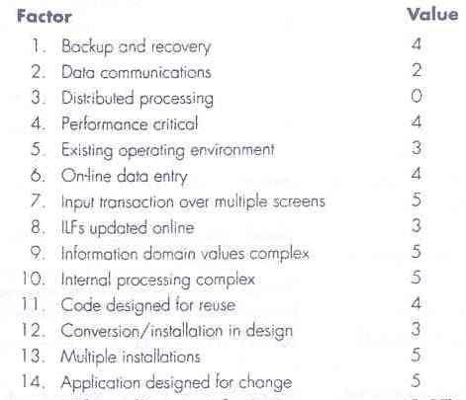
An Example of FP-Based Estimation
Value Adjustment Factors

Slide 22
An Example of FP-Based Estimation
Now,
  FP_{estimated} = count_total × [0.65 + 0.01 × Σ (F_{i})]
    F_{i} (i = 1 to 14 are value adjustment factors)
So,
  FP_{estimated} = W = 320 × [0.65 + 0.01 × 52] = 375
(approx.)
Let,
  Average Productivity = X = 6.5 FP/pm
  Labor rate = Y = $8,000 per month
So,
  Cost per FP = Z = Y/X = $1,230 (approx.)
  Total estimated project cost = W*Z = $461,000 (approx.)
  Estimated effort = W/X = 58 person months (approx)

Slide 23

Management Activities
in SE
Estimation in Agile Development (Recap)
Discussed before Mid 1

Slide 24
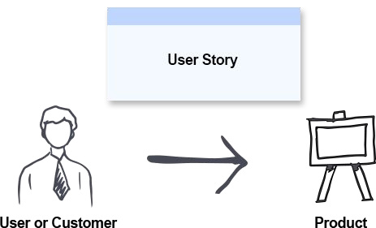
Estimation in Agile
Project Velocity
  The amount of work an agile team can complete in a sprint
Story Points
  The amount of effort required to implement a user story
User Story
  A requirement or general explanation of software feature

Slide 25

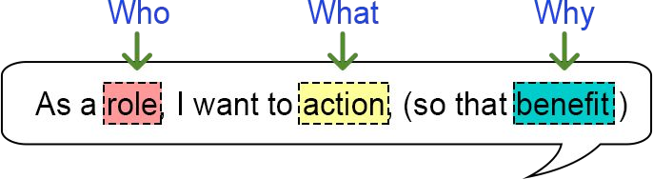
Examples of User Stories
As a [customer], I want [shopping cart feature] so that [I can easily purchase items online].
As an [manager], I want to [generate a report] so that [I can understand which departments need more resources].
As a [customer], I want to [receive an SMS when the item is arrived] so that [I can go pick it up right away]

Slide 26
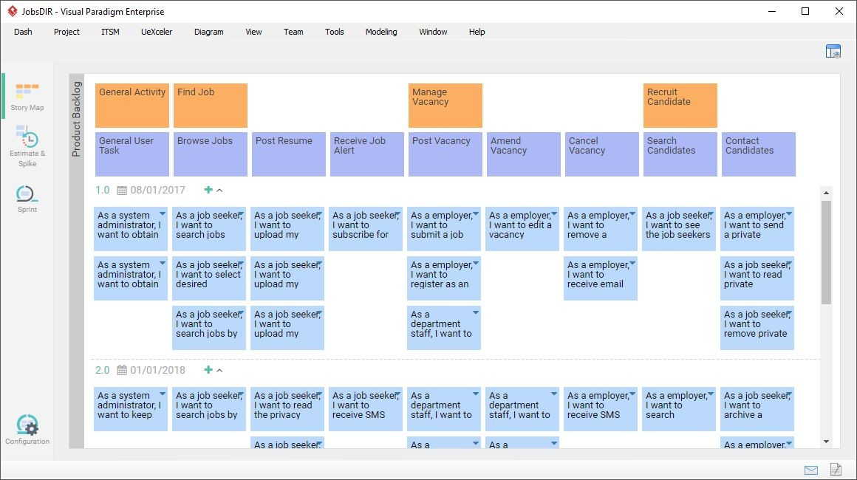
Example

Slide 27
Estimation in Agile
Project Velocity
  Story points completed ÷ Number of sprints

Slide 28
References
SE by Pfleeger
SE by Pressman
UCF slides for SE course

